Slide 1
CSC 3210 Computer Organization and Programming
Class Big Picture
Dr. Zulkar Nine
Department of Computer Science
Georgia State University

Slide 2
Outline
- What is a computer?
Microprocessor vs. Microcontroller
Microprocessors
- Computer Organization/ Architecture
Very High-Level View of a Computer
Von Neumann vs. Harvard Architecture
Memory Architectures
Architectural Differences
Instruction Set Architecture (ISA)
Different Computer Implementations
- Programming
Sample Program & Internal Structure
Instruction Cycle
Assembly Language Programming Tools

Slide 3
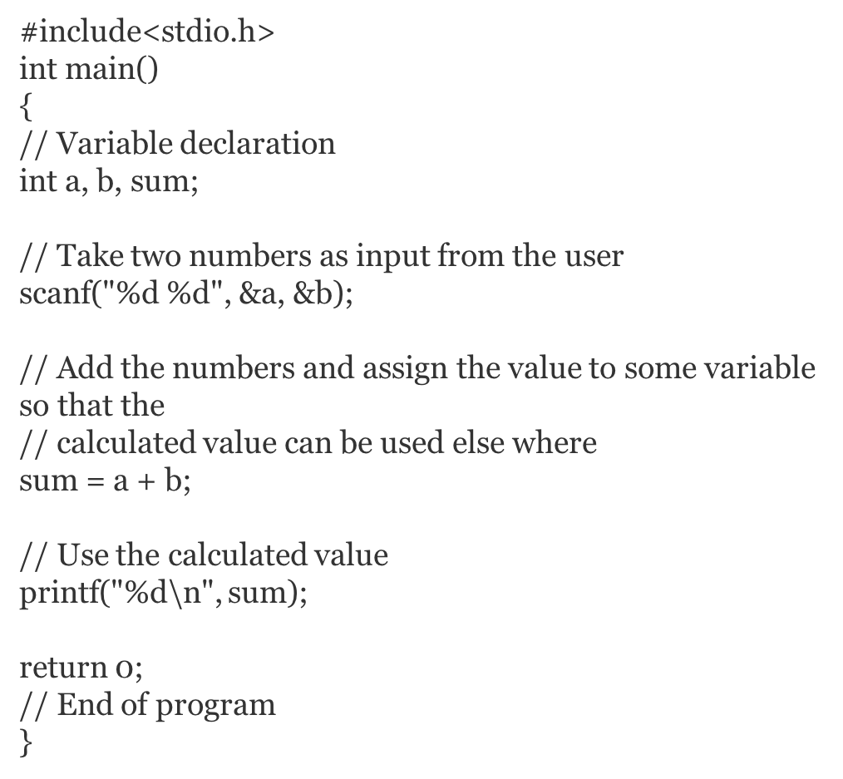
What is computer?
?
Computer Program
A mechanism that does two things:
It directs the processing of data and it performs the actual processing of data.
It does both of these things in response to a computer program.
Notes:
Computer architecture is a set of rules and methods that describe the functionality, organization, and implementation of computer systems.
Types of Computer architectures:
Von Neumann Architecture
Harvard Architecture
Von Neumann Architecture
A computer architecture conceived by mathematician John von Neumann
Microprocessor and microcontroller:
The term microprocessor and microcontroller have always been confused with each other. Both of them have been designed for real time application. They share many common features and at the same time they have significant differences. Both the IC’s i.e., the microprocessor and microcontroller cannot be distinguished by looking at them. They are available in different version starting from 6 pin to as high as 80 to 100 pins or even higher depending on the features. Difference between microprocessor and microcontroller Microprocessor is an IC which has only the CPU inside them i.e. only the processing powers such as Intel’s Pentium 1,2,3,4, core 2 duo, i3, i5 etc. These microprocessors don’t have RAM, ROM, and other peripheral on the chip. A system designer has to add them externally to make them functional. Application of microprocessor includes Desktop PC’s, Laptops, notepads etc. But this is not the case with Microcontrollers. Microcontroller has a CPU, in addition with a fixed amount of RAM, ROM and other peripherals all embedded on a single chip. At times it is also termed as a mini computer or a computer on a single chip. Today different manufacturers produce microcontrollers with a wide range of features available in different versions. Some manufacturers are ATMEL, Microchip, TI, Freescale, Philips, Motorola etc. Microcontrollers are designed to perform specific tasks. Specific means applications where the relationship of input and output is defined. Depending on the input, some processing needs to be done and output is delivered. For example, keyboards, mouse, washing machine, digicam, pendrive, remote, microwave, cars, bikes, telephone, mobiles, watches, etc. Since the applications are very specific, they need small resources like RAM, ROM, I/O ports etc and hence can be embedded on a single chip. This in turn reduces the size and the cost. Microprocessor find applications where tasks are unspecific like developing software, games, websites, photo editing, creating documents etc. In such cases the relationship between input and output is not defined. They need high amount of resources like RAM, ROM, I/O ports etc. The clock speed of the Microprocessor is quite high as compared to the microcontroller. Whereas the microcontrollers operate from a few MHz to 30 to 50 MHz, today’s microprocessor operate above 1GHz as they perform complex tasks. Read more about what is microcontroller. Comparing microcontroller and microprocessor in terms of cost is not justified. Undoubtedly a microcontroller is far cheaper than a microprocessor. However microcontroller cannot be used in place of microprocessor and using a microprocessor is not advised in place of a microcontroller as it makes the application quite costly. Microprocessor cannot be used stand alone. They need other peripherals like RAM, ROM, buffer, I/O ports etc and hence a system designed around a microprocessor is quite costly.

Slide 4
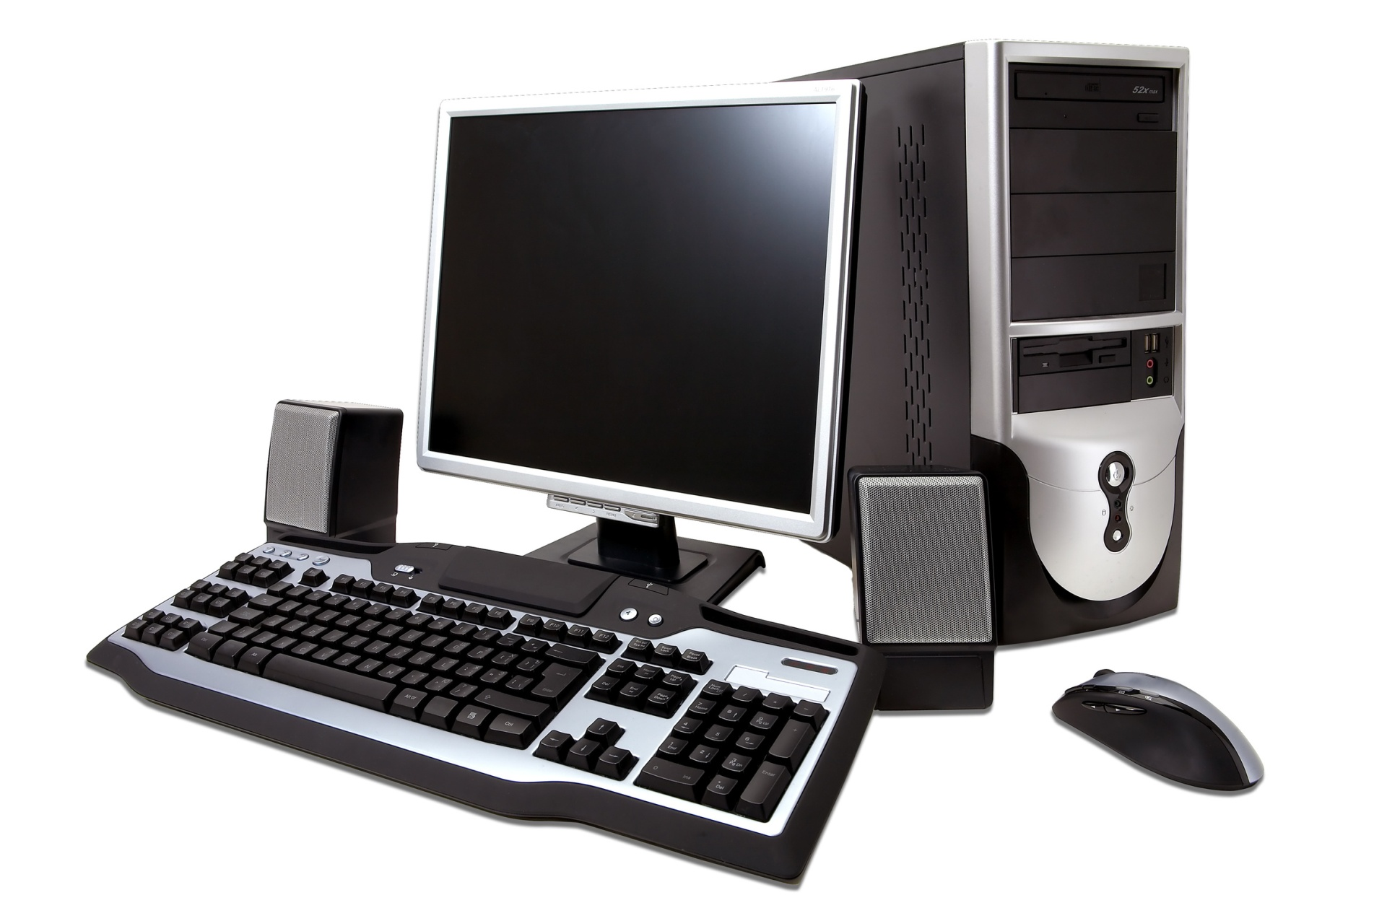
What is computer? Outside
- Processor
- Memory
- Hard disk
- DVD ROM
- Graphics card
- Ethernet
Output
Input

Slide 5
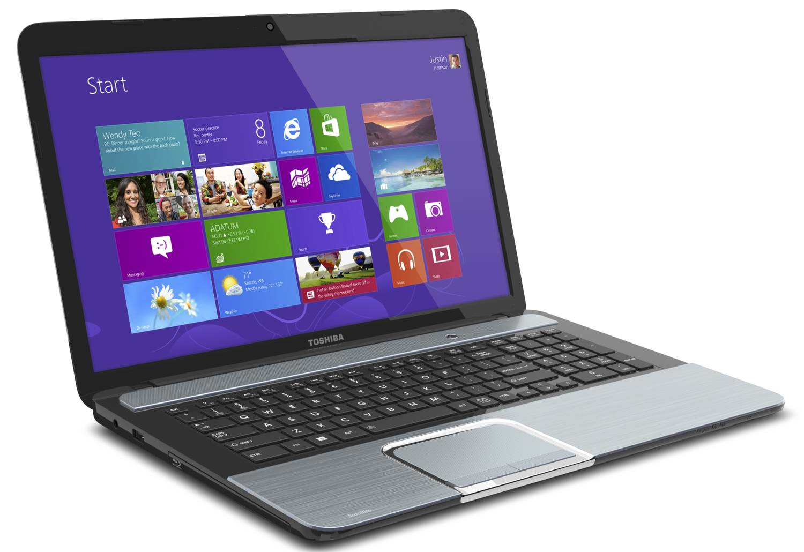
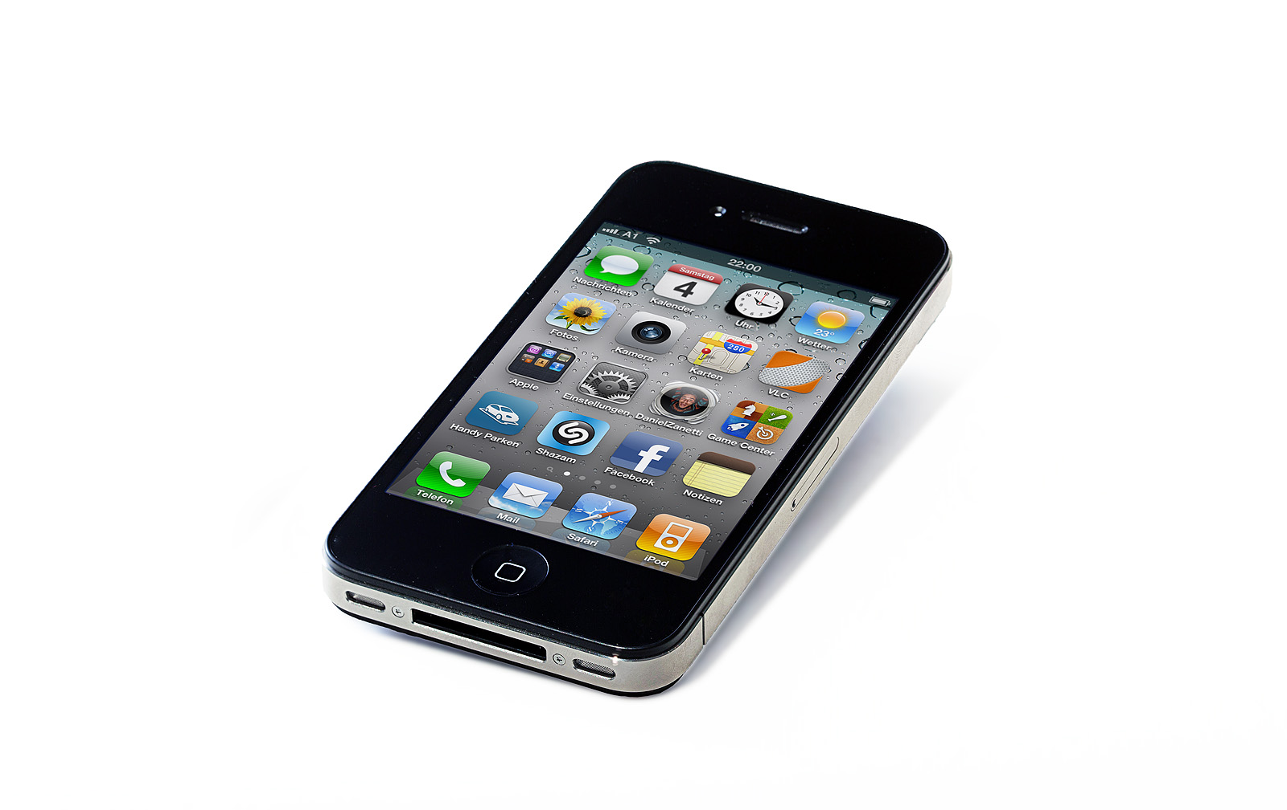
What is computer? Outside
- Touch pad
- Touch screen
- Wireless
- Screen size
- Weight
- Battery capacity
- SD Card slot
- Sensors

Slide 6
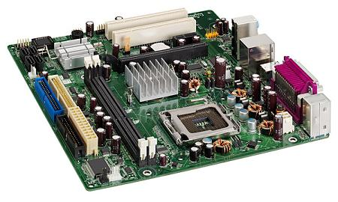
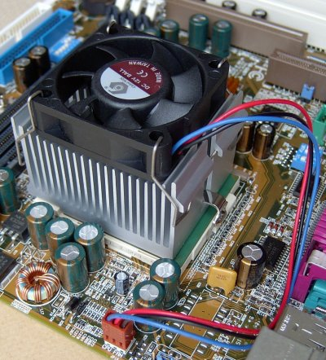
What is computer? Inside (Desktop)

Slide 7
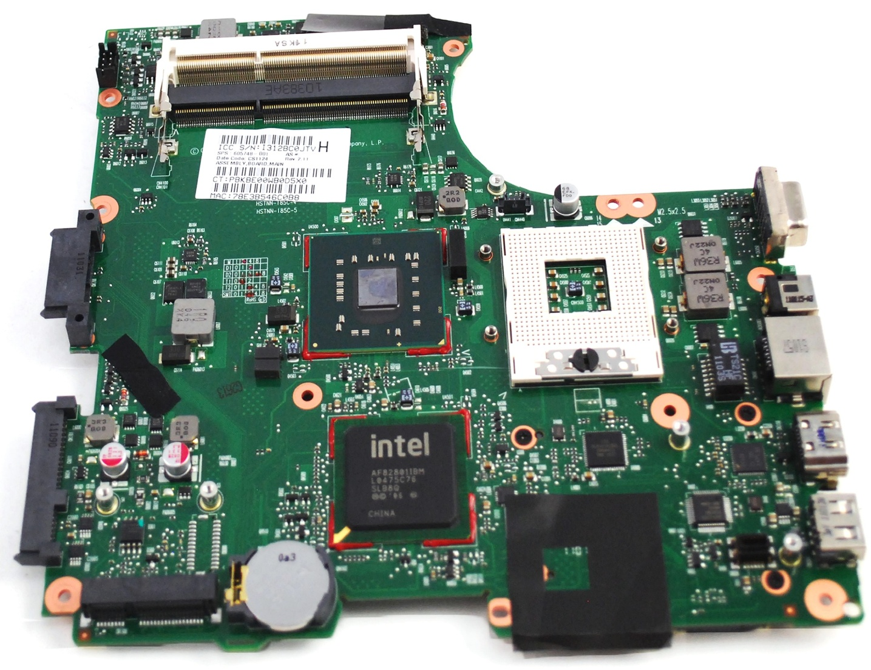
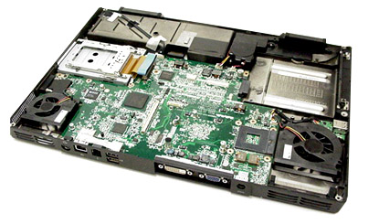
What is computer? Inside (Laptop)

Slide 8
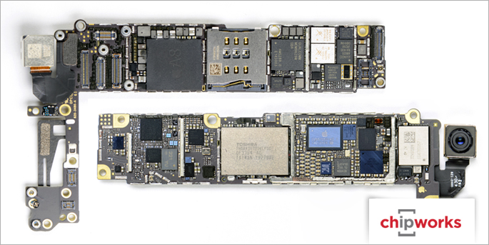
What is computer? Inside (smart phone)

Slide 9
Are these computers too?

Slide 10
Microprocessor vs. Microcontroller
Microprocessor
Microcontroller
Microprocessor – CPU & various IO functions are packed as separate ICs
Microcontroller – Most IO functions are integrated into same package with CPU
Notes:
Microprocessor and microcontroller:
The term microprocessor and microcontroller have always been confused with each other. Both of them have been designed for real time application. They share many common features and at the same time they have significant differences. Both the IC’s i.e., the microprocessor and microcontroller cannot be distinguished by looking at them. They are available in different version starting from 6 pin to as high as 80 to 100 pins or even higher depending on the features. Difference between microprocessor and microcontroller Microprocessor is an IC which has only the CPU inside them i.e. only the processing powers such as Intel’s Pentium 1,2,3,4, core 2 duo, i3, i5 etc. These microprocessors don’t have RAM, ROM, and other peripheral on the chip. A system designer has to add them externally to make them functional. Application of microprocessor includes Desktop PC’s, Laptops, notepads etc. But this is not the case with Microcontrollers. Microcontroller has a CPU, in addition with a fixed amount of RAM, ROM and other peripherals all embedded on a single chip. At times it is also termed as a mini computer or a computer on a single chip. Today different manufacturers produce microcontrollers with a wide range of features available in different versions. Some manufacturers are ATMEL, Microchip, TI, Freescale, Philips, Motorola etc. Microcontrollers are designed to perform specific tasks. Specific means applications where the relationship of input and output is defined. Depending on the input, some processing needs to be done and output is delivered. For example, keyboards, mouse, washing machine, digicam, pendrive, remote, microwave, cars, bikes, telephone, mobiles, watches, etc. Since the applications are very specific, they need small resources like RAM, ROM, I/O ports etc and hence can be embedded on a single chip. This in turn reduces the size and the cost. Microprocessor find applications where tasks are unspecific like developing software, games, websites, photo editing, creating documents etc. In such cases the relationship between input and output is not defined. They need high amount of resources like RAM, ROM, I/O ports etc. The clock speed of the Microprocessor is quite high as compared to the microcontroller. Whereas the microcontrollers operate from a few MHz to 30 to 50 MHz, today’s microprocessor operate above 1GHz as they perform complex tasks. Read more about what is microcontroller. Comparing microcontroller and microprocessor in terms of cost is not justified. Undoubtedly a microcontroller is far cheaper than a microprocessor. However microcontroller cannot be used in place of microprocessor and using a microprocessor is not advised in place of a microcontroller as it makes the application quite costly. Microprocessor cannot be used stand alone. They need other peripherals like RAM, ROM, buffer, I/O ports etc and hence a system designed around a microprocessor is quite costly.

Slide 11
Microprocessor vs. Microcontroller
Microcontroller
Microprocessor
✅ Intel x86
Notes:
Tus, Aug 29 9:30,
Microprocessor and microcontroller:
The term microprocessor and microcontroller have always been confused with each other. Both of them have been designed for real time application. They share many common features and at the same time they have significant differences. Both the IC’s i.e., the microprocessor and microcontroller cannot be distinguished by looking at them. They are available in different version starting from 6 pin to as high as 80 to 100 pins or even higher depending on the features. Difference between microprocessor and microcontroller Microprocessor is an IC which has only the CPU inside them i.e. only the processing powers such as Intel’s Pentium 1,2,3,4, core 2 duo, i3, i5 etc. These microprocessors don’t have RAM, ROM, and other peripheral on the chip. A system designer has to add them externally to make them functional. Application of microprocessor includes Desktop PC’s, Laptops, notepads etc. But this is not the case with Microcontrollers. Microcontroller has a CPU, in addition with a fixed amount of RAM, ROM and other peripherals all embedded on a single chip. At times it is also termed as a mini computer or a computer on a single chip. Today different manufacturers produce microcontrollers with a wide range of features available in different versions. Some manufacturers are ATMEL, Microchip, TI, Freescale, Philips, Motorola etc. Microcontrollers are designed to perform specific tasks. Specific means applications where the relationship of input and output is defined. Depending on the input, some processing needs to be done and output is delivered. For example, keyboards, mouse, washing machine, digicam, pendrive, remote, microwave, cars, bikes, etc. Since the applications are very specific, they need small resources like RAM, ROM, I/O ports etc and hence can be embedded on a single chip. This in turn reduces the size and the cost. Microprocessor find applications where tasks are unspecific like developing software, games, websites, photo editing, creating documents etc. In such cases the relationship between input and output is not defined. They need high amount of resources like RAM, ROM, I/O ports etc. The clock speed of the Microprocessor is quite high as compared to the microcontroller. Whereas the microcontrollers operate from a few MHz to 30 to 50 MHz, today’s microprocessor operate above 1GHz as they perform complex tasks. Read more about what is microcontroller. Comparing microcontroller and microprocessor in terms of cost is not justified. Undoubtedly a microcontroller is far cheaper than a microprocessor. However microcontroller cannot be used in place of microprocessor and using a microprocessor is not advised in place of a microcontroller as it makes the application quite costly. Microprocessor cannot be used stand alone. They need other peripherals like RAM, ROM, buffer, I/O ports etc and hence a system designed around a microprocessor is quite costly.

Slide 12
Microprocessor
- x86
Based on Intel 8086 CPU in 1978
Intel family, also followed by AMD
X86-64
64-bit extensions
Proposed by AMD, also followed by Intel
- ARM
32-bit & 64-bit
Initially by Acorn RISC Machine
ARM Holding
- MIPS
32-bit & 64-bit
By Microprocessor without Interlocked Pipeline Stages (MIPS) Technologies
- SPARC
32-bit & 64-bit
By Sun Microsystems
- PIC
8-bit to 32-bit
By Microchip
- Z80
8-bit
By Zilog in 1976
- Many extensions
Intel – MMX, SSE, SSE2, AVX
AMD – 3D Now!
Notes:
Microprocessor and microcontroller:
The term microprocessor and microcontroller have always been confused with each other. Both of them have been designed for real time application. They share many common features and at the same time they have significant differences. Both the IC’s i.e., the microprocessor and microcontroller cannot be distinguished by looking at them. They are available in different version starting from 6 pin to as high as 80 to 100 pins or even higher depending on the features. Difference between microprocessor and microcontroller Microprocessor is an IC which has only the CPU inside them i.e. only the processing powers such as Intel’s Pentium 1,2,3,4, core 2 duo, i3, i5 etc. These microprocessors don’t have RAM, ROM, and other peripheral on the chip. A system designer has to add them externally to make them functional. Application of microprocessor includes Desktop PC’s, Laptops, notepads etc. But this is not the case with Microcontrollers. Microcontroller has a CPU, in addition with a fixed amount of RAM, ROM and other peripherals all embedded on a single chip. At times it is also termed as a mini computer or a computer on a single chip. Today different manufacturers produce microcontrollers with a wide range of features available in different versions. Some manufacturers are ATMEL, Microchip, TI, Freescale, Philips, Motorola etc. Microcontrollers are designed to perform specific tasks. Specific means applications where the relationship of input and output is defined. Depending on the input, some processing needs to be done and output is delivered. For example, keyboards, mouse, washing machine, digicam, pendrive, remote, microwave, cars, bikes, telephone, mobiles, watches, etc. Since the applications are very specific, they need small resources like RAM, ROM, I/O ports etc and hence can be embedded on a single chip. This in turn reduces the size and the cost. Microprocessor find applications where tasks are unspecific like developing software, games, websites, photo editing, creating documents etc. In such cases the relationship between input and output is not defined. They need high amount of resources like RAM, ROM, I/O ports etc. The clock speed of the Microprocessor is quite high as compared to the microcontroller. Whereas the microcontrollers operate from a few MHz to 30 to 50 MHz, today’s microprocessor operate above 1GHz as they perform complex tasks. Read more about what is microcontroller. Comparing microcontroller and microprocessor in terms of cost is not justified. Undoubtedly a microcontroller is far cheaper than a microprocessor. However microcontroller cannot be used in place of microprocessor and using a microprocessor is not advised in place of a microcontroller as it makes the application quite costly. Microprocessor cannot be used stand alone. They need other peripherals like RAM, ROM, buffer, I/O ports etc and hence a system designed around a microprocessor is quite costly.

Slide 13
Computer Organization/Architecture: Very High-Level View of a Computer
Main Memory
Central Processing Unit (CPU)
System Bus
Input/output (IO) Devices
- CPU – execute instructions
- Memory – store program & data
- IO devices – receive inputs & produce outputs
- Bus – interconnects everything by transferring data

Slide 14
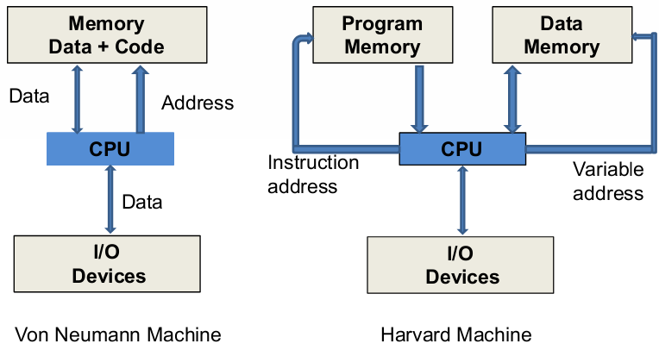
Von Neumann vs. Harvard Architecture
Source: Introduction to PIC Microcontroller – Part 1 by Khan Wahid

Slide 15
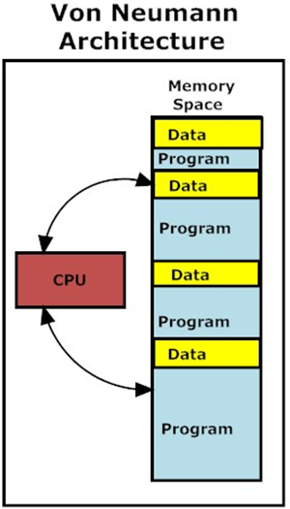
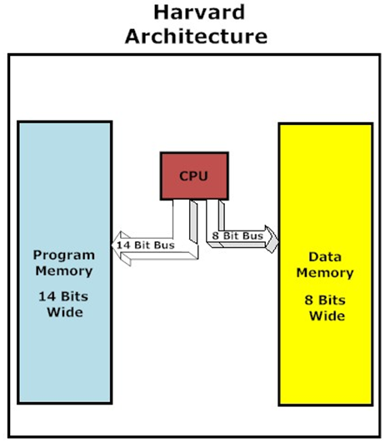
Memory Architectures
Source: Introduction to PIC Microcontroller – Part 1 by Khan Wahid
Notes:
W1-Monday,21

Slide 16
Architectural Differences
Length of microprocessors’ data word
4, 8, 16, 32, 64, & 128 bit
Speed of instruction execution
Clock rate & processor speed
Size of direct addressable memory
CPU architecture
Instruction set
Number & types of registers
Support circuits
Compatibility with existing software & hardware development systems

Slide 17
Instruction Set Architecture (ISA)
SPARC
Intel
mov 5,r1
mov 6,r2
add r1,r2,r3
mov eax,5
add eax,6
Software
Instruction Set
Hardware
Source: Computer Architecture: A Quantitative Approach, J. L. Hennessy & D. A. Patterson, 3rd Edition.

Slide 18
Instruction Set Architecture (ISA)
Part of computer architecture related to programming
Include native data types, instructions, registers, addressing modes, memory architecture, interrupt & exception handling, & external I/O
e.g., R1, R2, …, PC, IR
e.g., MOV, ADD, INC, AND
ISA specifies the set of opcodes (machine language), & native commands implemented by a particular processor
ISA for x86

Slide 19
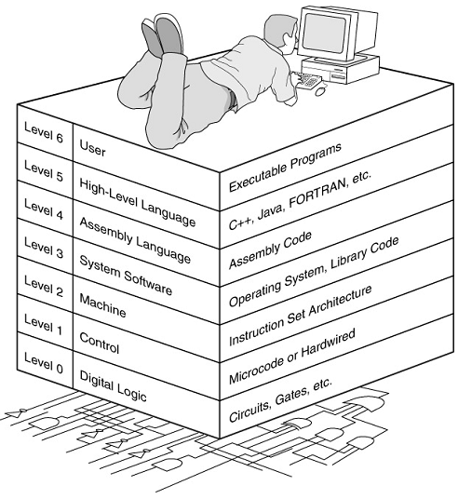
Programming
Source: Introduction to PIC Microcontroller – Part 1 by Khan Wahid

Slide 20
Sample Program & Internal Structure
100: Load A,10
101: Load B,15
102: Add A,B
103: STORE A,[20]
Address Bus
B
PC
+1
C
ALU
D
100
Load A,10
18
00
Data Bus
101
Load B,15
00
IR
E
19
102
ADD A,B
20
00
Control Unit
103
STORE A,[20]
104
21
00
CTRL Bus
ALU
105
Data memory
Program memory
FLAG
A

Slide 21
Instruction Cycle (Load or Add instruction)
Fetch next instruction from memory to IR
Change PC to point to next instruction
Determine type of instruction just fetched
If instruction needs data from memory, determine where it is
Fetch data if needed into register
Execute instruction
Go to step 1 and continue with next instruction

Slide 22
Assembly Language Programming Tools
Editor
Allows you to create and edit assembly language source files
Assembler
Converts assembly language programs into object files
Object files contain the machine instructions
Linker
Combines object files created by the assembler with link libraries
Produces a single executable program
Debugger
Allows you to trace the execution of a program
Allows you to view machine instructions, memory, and registers

